Slide 1




Numerical Problem Solving across the Curriculum with Python and MATLAB Using Interactive Coding Templates
Presenters:
Ashlee N. Ford Versypt, University at Buffalo
Matthew D. Stuber, University of Connecticut
Robert P. Hesketh, Rowan University
ashleefv@buffalo.edu
matthew.stuber@uconn.edu
hesketh@rowan.edu
Assisted by Austin Johns, anjohns@buffalo.edu
Notes:
AFV

Slide 2
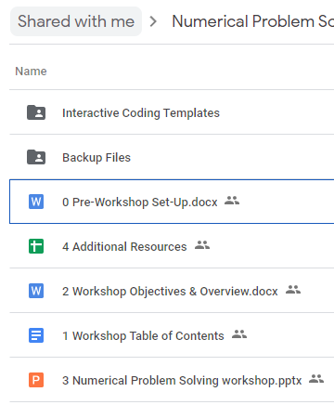
Pre-Workshop Set-Up
Pre-Workshop Set-Up Link
Access workshop Google Drive folder
Open interactive coding templates
Obtain MATLAB license (.mlx)
OR
Google Colab (.ipynb)
Notes:
AFV

Slide 3
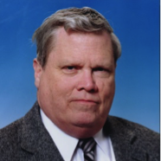
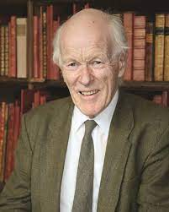
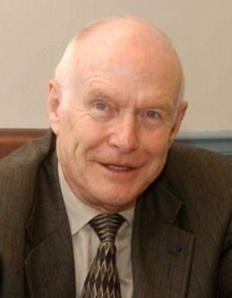
Robert Hesketh
B.S. University of Illinois, Champaign-Urbana, May 1982
Ph.D. University of Delaware, May 1987
Postdoc University of Cambridge, 1987
University of Tulsa, 1990
Rowan University, 1996
Notes:
Robert

Slide 4
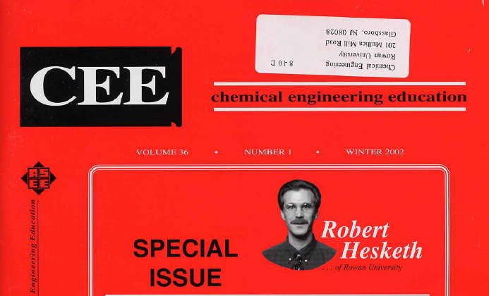
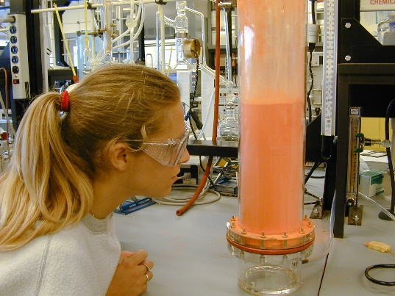
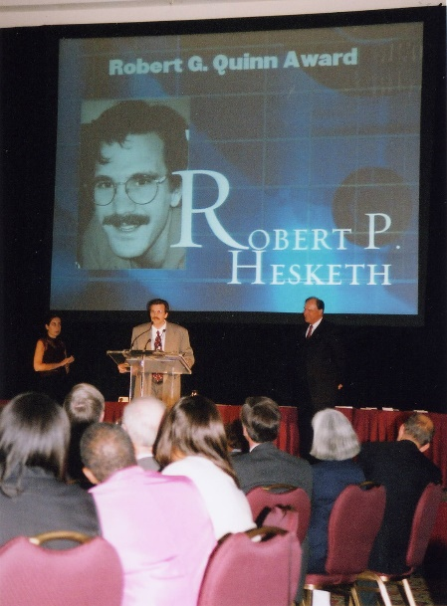
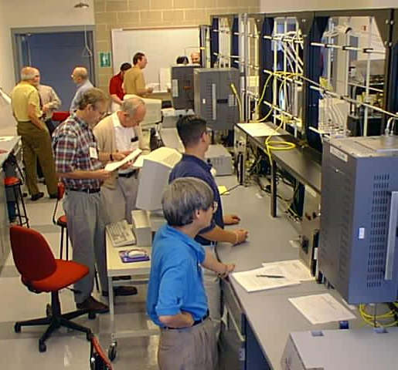
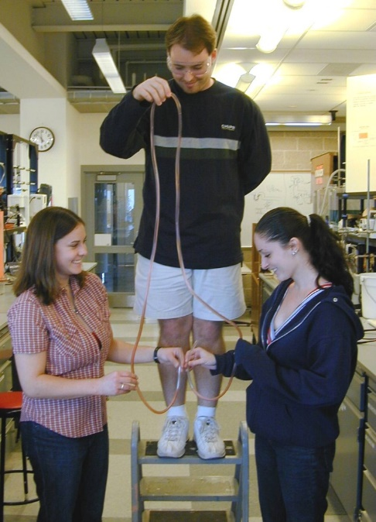

CACHE Trustee
ASEE Chester F. Carlson 2006
ASEE Robert G. Quinn 2002
AIChE Gary Leach 2007
ASEE Chester F. Carlson 2006
Featured Educator, Chemical Engineering Education, 37(1) 2003
ASEE Robert G. Quinn 2002 Award
ASEE Ray W. Fahien Award 1999
ASEE Joseph J. Martin Awards
Dow Outstanding New Faculty Award ASEE
Vol. 37 No. 1 (2003): Winter 2003
Notes:
Robert

Slide 5
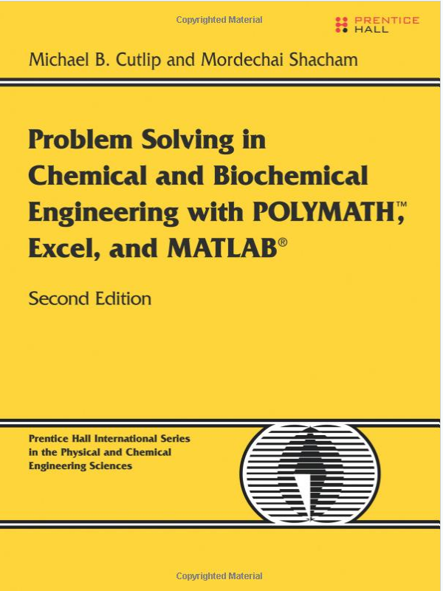
Robert’s Use of Python in the Classroom
Mass & Energy Balance (Felder, Rousseau, Bullard)
ChE Fluid Mechanics (fluids 1)
Process Fluid Transport (fluids 2)
Separations I
Chemical Reaction Engineering
Transport Phenomena
Grad Classes
Notes:
Robert

Slide 6









Matthew D. Stuber
Academics
PhD MIT, 2013
BChE UMN-TC, 2007
Professional
Asst. Prof., University of Connecticut, 2016
Entrepreneurial, 2012
Teaching
Optimization
Numerical Analysis
Robust Design
MIT Teaching Certificate
UConn CETL Online Course Design
UConn CETL Mini-Grant Competition
CACHE Grant Award
Notes:
Matthew

Slide 7

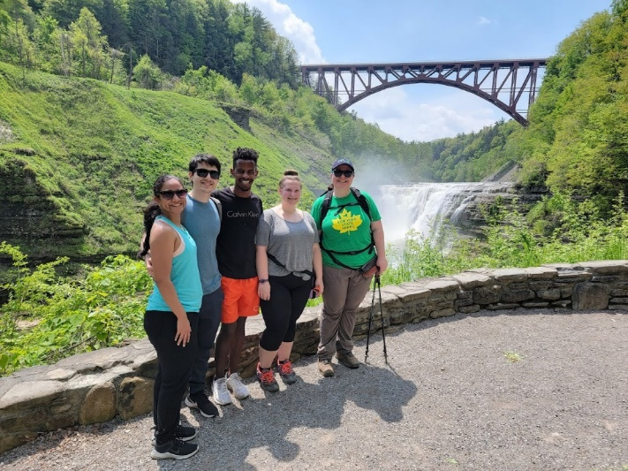
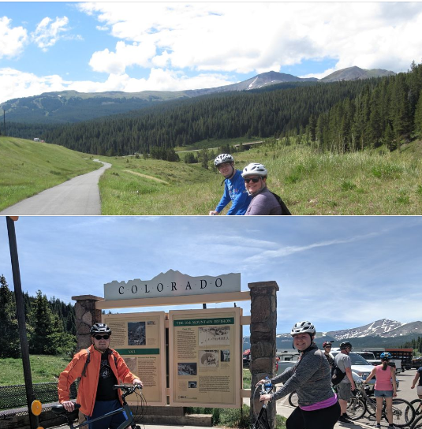
Ashlee N. Ford Versypt (Pronounced: Ford Vurr-SIPPED)
Pronouns: she/her/hers
Associate Professor
Dept. of Chemical & Biological Engineering
University at Buffalo
Starting 9th year as faculty, 15th semester of teaching
PhD UIUC 2012 (ChE + Computational Science & Engineering)
BS OU 2005, postdoc MIT 2012-2014, Asst Prof OK State 2014-2021
Why I am teaching this course
Have taught kinetics, fluids, heat transfer, process control, mass and energy balances, grad math (analytical & numerical methods), and a hands-on elective “applied numerical computing” featuring MATLAB & Python
I’m very passionate about engineering education and computing
I use math and computing applied to ChE principles for my research
CACHE Trustee, AIChE CAST & ASEE CHED Exec Comm member
AIChE CAST Himmelblau Award for Innovations in Computer-Based Chemical Engineering Education, UIUC Teaching Certificate, ASEE Fahien Award, NSF CAREER, DOE CSGF, CACHE minigrant
Notes:
AFV

Slide 8

CACHE Development of Computational-Based Tools & Modules for Chemical Engineering Education RFP
Project Goal
This program seeks to fund 12-month-long projects (maximum budget of $5000 per project) that focus on the development of novel computational-based educational modules or tools.
Proposals are due by 5 pm EDST, August 31, 2022 and awards will be made by October 1, 2022. Details related to proposal preparation and submission can be found at https://cache.org/computational-tools-development
Examples of Past Projects
Modernizing the ChE Curriculum via Interactive Visual Aids for Traditional Courses
Development of Open Access Version of Applied Numerical Computing Course (Ford Versypt)
Coding Concepts and Chemical Engineering Analysis With Interactive Jupyter Notebooks (Stuber)
Notes:
AFV

Slide 9
Learning objectives for the workshop
By the end of this workshop, participants will be able to
Create interactive coding templates (MATLAB Live Scripts or Jupyter Notebooks using Python) for teaching chemical engineering concepts and problem-solving
Select, run, and interact with a MATLAB Live Script or Jupyter Notebook template applied to a chemical engineering topic of their choice
Notes:
AFV

Slide 10
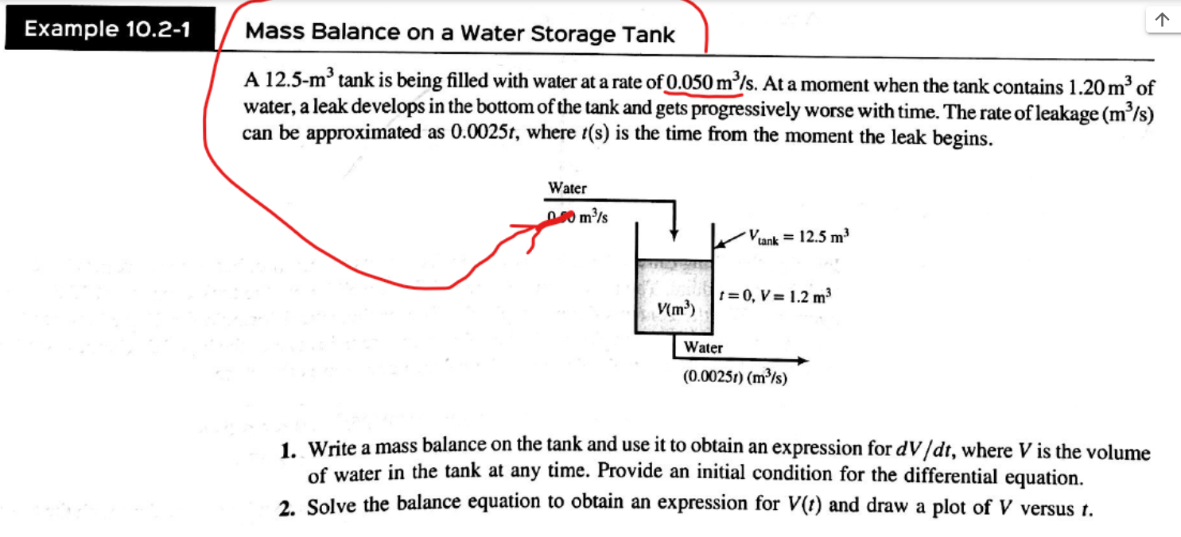
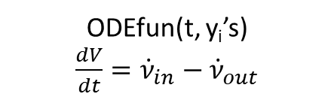
Example interactive coding templates
Ex. 10.2-1 from MEB book by Felder, Rousseau, & Bullard
Jupyter Notebook (Python) version: J6_TankDrainage.ipynb
MATLAB version: M6_TankDrainage.mlx
Notes:
Robert, ~10min

Slide 11
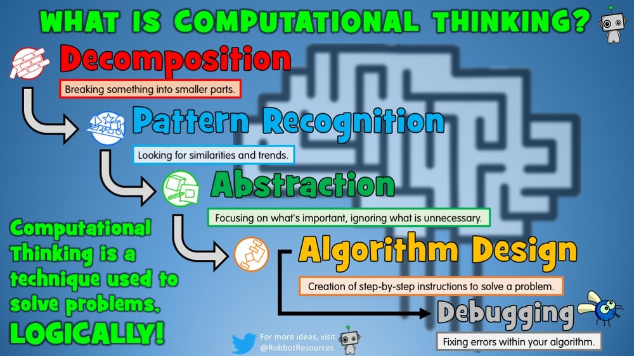
Educational goal: computational thinking for problem solving
Notes:
Matthew
“Computational Thinking” is not a well-defined taxonomy, but (according to Shute et al. 2017) most sources agree on five major cognitive processes that computational thinkers engage: problem reformulation, recursion, problem decomposition, abstraction, and systematic testing. The core competency model for computational thinking consists of decomposition, abstraction, algorithms, debugging, iteration, and generalization.
The overall idea is not that exceptional problem solvers are trained to think computationally, and this does not require a computer.

Slide 12
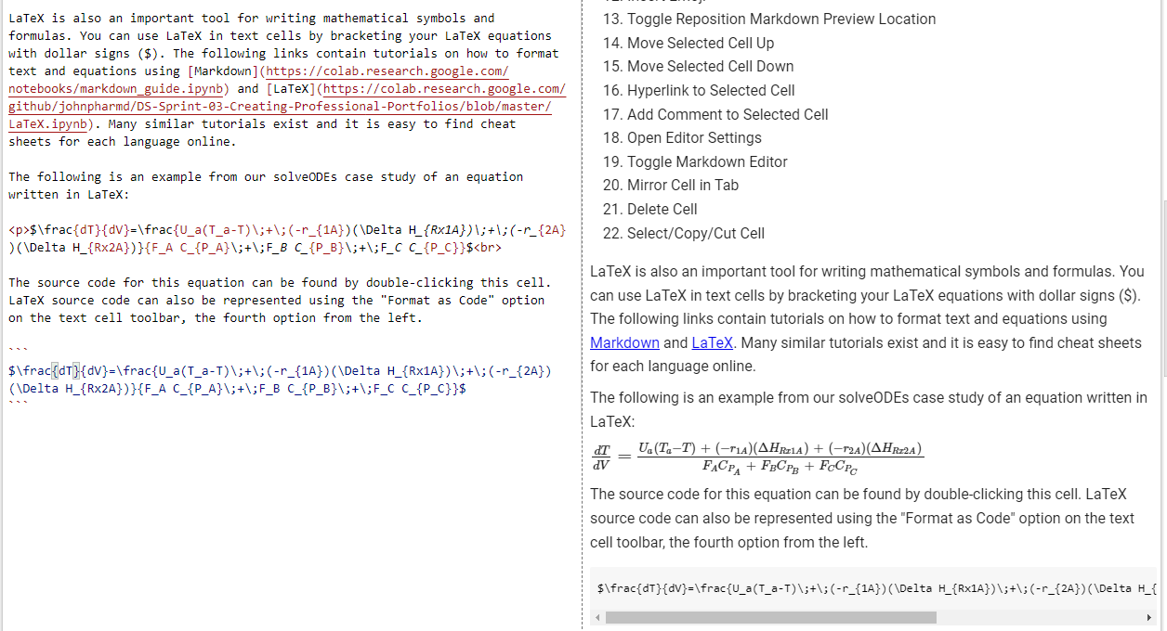
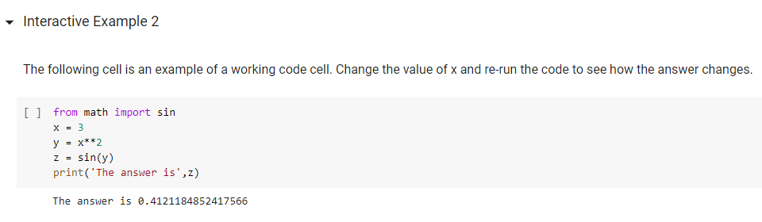
Literate programming making code human readable
Focus on natural language
Text and code blocks
Formatting for clear documentation
Alternative to extensive commenting
Educational applications
Markup language vs programming language
Literate Programming - Wikipedia
Notes:
Matthew

Slide 13
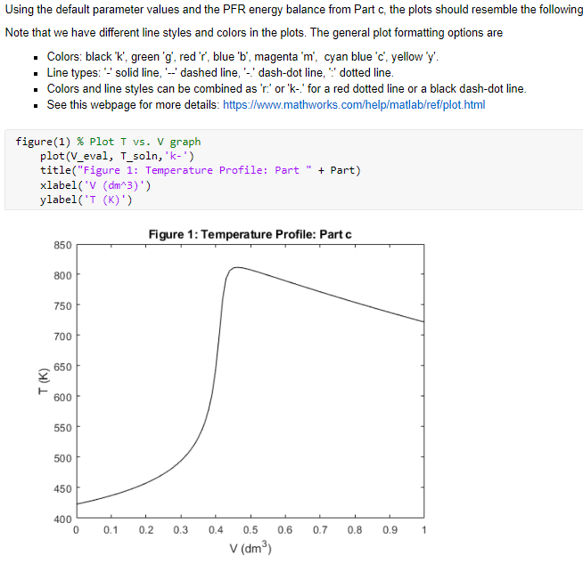
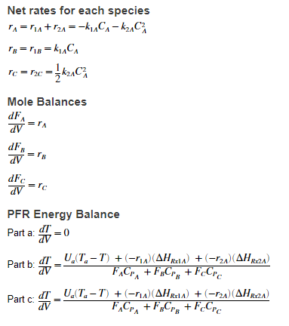
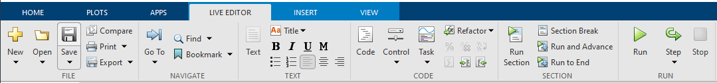
MATLAB Live Script (.mlx)
MathWorks literate programming
Works using online and standalone client
MATLAB code + Simplified Markdown
LaTeX available for equations
Functions defined at end of document
Interactive elements
Notes:
Matthew

Slide 14
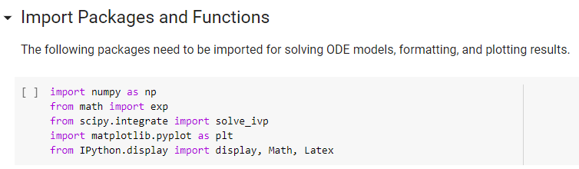
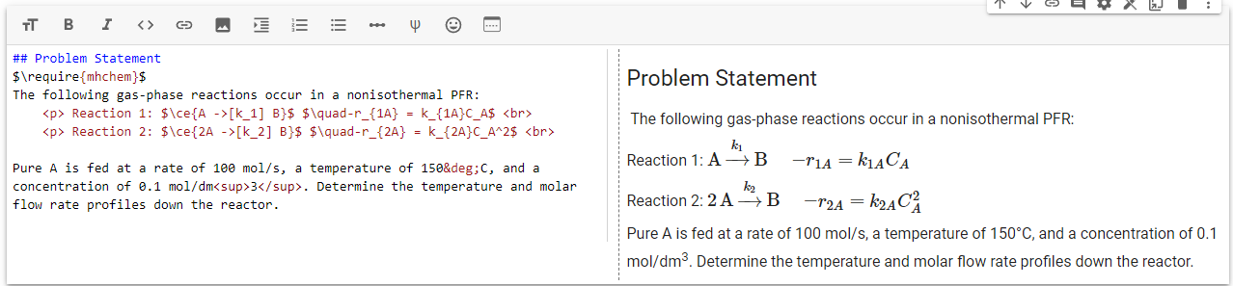
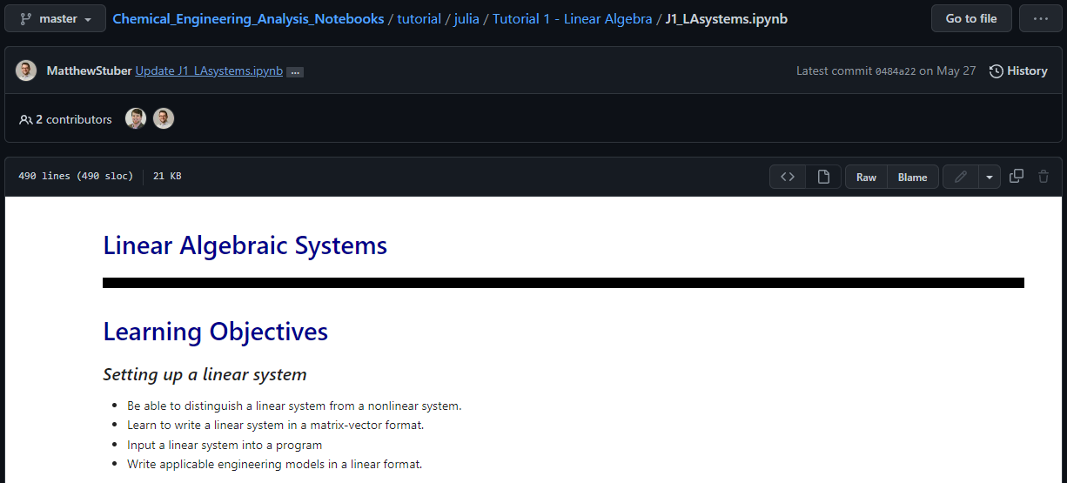
Jupyter Notebook (.ipynb)
Open-source literate programming option
Works using online and standalone client
Google Colab opens directly from Google Drive
Python code + Markdown default
>40 programming languages available
Functions must run before called
Notebooks render directly on GitHub
Non-interactive / Read-only
Notes:
Matthew

Slide 15
Ways to use these interactive coding templates in ChE classrooms across the curriculum
Reinforce computational thinking
Introduce/enhance familiarity with MATLAB and/or Python
Student use cases
Lecture notes with in-class activities
Pre-class readings with embedded activities
Worked example case studies
In-class problems
Homework or project problems
Notes:
Matthew

Slide 16
Modeling a student use case: reading with embedded interactive activities
Choose either MATLAB Live Script or Jupyter Notebook (Google Colab)
Open M0_HowToCreate.mlx or J0_HowToCreate.ipynb file on How to create a MATLAB Live Script/How to create a Jupyter Notebook
Read through the file and complete the interactive activities
We will circulate to answer your questions
Notes:
Matthew, ~20min

Slide 17
Your turn to build your own interactive coding template
Choose either MATLAB Live Script or Jupyter Notebook (Google Colab)
Find a partner who is interested in using the same language (MATLAB or Python)
Work together to build a notebook for students to solve an equation of your choice. The notebook must include code blocks for numerical computation (solving) and the following text blocks (in any order)
learning objectives
problem statement
mathematical equation(s)
an image
Notes:
AFV, ~30min

Slide 18
Going further: case study examples to explore in groups
We have prepared a set of interactive coding templates that correspond to mathematical topics and chemical engineering topics across the curriculum.
Pick a file from our set of templates. Play with the interface and reflect on how to adapt for your purposes: lecture/in-class activity, homework, group projects, other.
Workshop Table of Contents
Notes:
AFV

Slide 19
More computational educational materials from us
Video highlighting key features of MATLAB Live Scripts and Jupyter Notebooks (Austin Johns, Ford Versypt Lab): https://youtu.be/u5YkzFl6FbE
Ford Versypt: https://github.com/ashleefv/ApplNumComp
Hesketh: https://github.com/heskethrp
Stuber: https://github.com/PSORLab/Chemical_Engineering_Analysis_Notebooks
Shareable Handout
Notes:
AFV

Slide 20
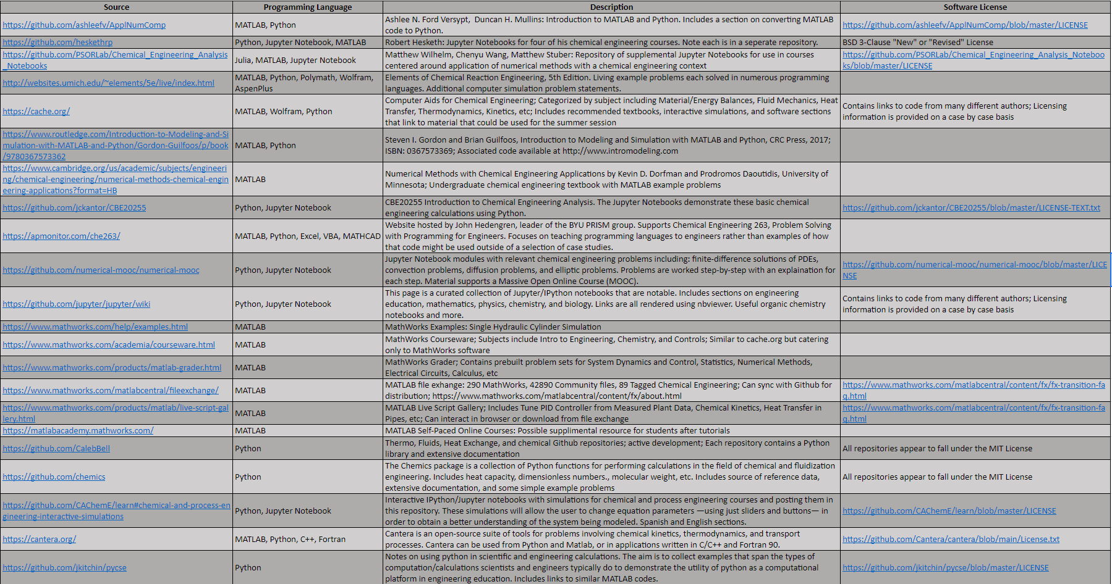
More related computational educational materials from others
Additional Resources
Notes:
AFV

